Slide 1
TensorFlow Sentiment Analysis via Embeddings
COMP 4230

Slide 2
ALERTS
Read Moroney Chapter 6
Read Larson Chapter 11

Slide 3
Discussion
What is deduction?
What is induction?
What is abduction?
Class discussion on Friday
Make sure to bring your book and be caught up on readings

Slide 4
What is Sentiment Analysis?
Also known as opinion extraction, opinion mining, or subjectivity analysis
"The use of natural language processing, text analysis, computational linguistics, and biometrics to systematically identify, extract, quantify, and study affective states and subjective information." —Wikipedia
It has the goal of understanding whether the sentiment behind a piece of text is positive, negative, or neutral.

Slide 5
Positive or negative movie review?
unbelievably disappointing
Full of zany characters and richly applied satire, and some great plot twists
this is the greatest screwball comedy ever filmed
It was pathetic. The worst part about it was the boxing scenes.

Slide 6
Google Product Search
a

Slide 7
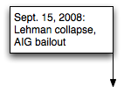
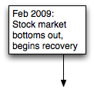
Twitter sentiment versus Gallup Poll of Consumer Confidence
Brendan O'Connor, Ramnath Balasubramanyan, Bryan R. Routledge, and Noah A. Smith. 2010. From Tweets to Polls: Linking Text Sentiment to Public Opinion Time Series. In ICWSM-2010
Notes:
Thanks to Brendan O’Connor and Noah Smith (email, 1/18/12) for permission to use this figure.

Slide 8
Why sentiment analysis?
Movie: is this review positive or negative?
Products: what do people think about the new iPhone?
Public sentiment: how is consumer confidence? Is despair increasing?
Politics: what do people think about this candidate or issue?
Prediction: predict election outcomes or market trends from sentiment

Slide 9
Scherer Typology of Affective States
Emotion: brief organically synchronized … evaluation of a major event
angry, sad, joyful, fearful, ashamed, proud, elated
Mood: diffuse non-caused low-intensity long-duration change in subjective feeling
cheerful, gloomy, irritable, listless, depressed, buoyant
Interpersonal stances: affective stance toward another person in a specific interaction
friendly, flirtatious, distant, cold, warm, supportive, contemptuous
Attitudes: enduring, affectively colored beliefs, dispositions towards objects or persons
liking, loving, hating, valuing, desiring
Personality traits: stable personality dispositions and typical behavior tendencies
nervous, anxious, reckless, morose, hostile, jealous

Slide 10
Scherer Typology of Affective States
Emotion: brief organically synchronized … evaluation of a major event
angry, sad, joyful, fearful, ashamed, proud, elated
Mood: diffuse non-caused low-intensity long-duration change in subjective feeling
cheerful, gloomy, irritable, listless, depressed, buoyant
Interpersonal stances: affective stance toward another person in a specific interaction
friendly, flirtatious, distant, cold, warm, supportive, contemptuous
Attitudes: enduring, affectively colored beliefs, dispositions towards objects or persons
liking, loving, hating, valuing, desiring
Personality traits: stable personality dispositions and typical behavior tendencies
nervous, anxious, reckless, morose, hostile, jealous

Slide 11
Sentiment Analysis
Sentiment analysis is the detection of attitudes
“enduring, affectively colored beliefs, dispositions towards objects or persons”
Holder (source) of attitude
Target (aspect) of attitude
Type of attitude
From a set of types
Like, love, hate, value, desire, etc.
Or (more commonly) simple weighted polarity:
positive, negative, neutral, together with strength
Text containing the attitude
Sentence or entire document

Slide 12
Simplistic Example
If a sentence is negative, we can assume that each word contributes equally to this sentiment; likewise if the sentence is positive
Associate with each word in the training data the sum of positive and negative sentences it participates in. This is a relative measure of a word's positivity/negativity
Given a test sentence, add up the values of all the words to predict whether the sentence is positive or negative
What seem to be the weaknesses with this idea?

Slide 13
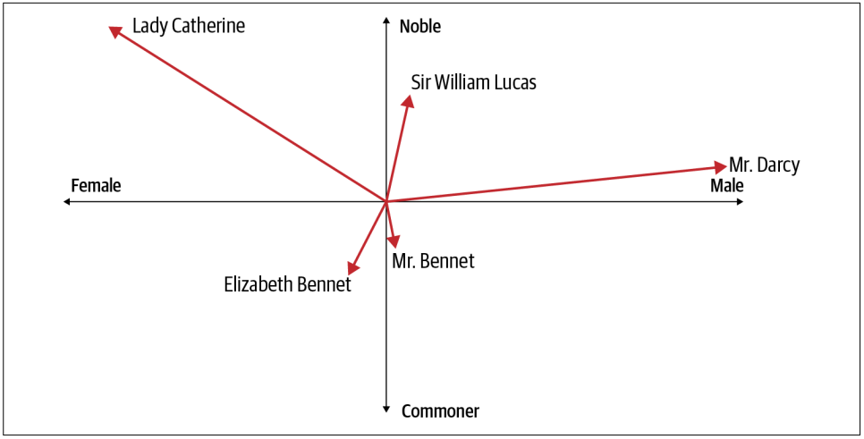
Vectors
The simplistic example used a one dimensional measure
More nuanced discrimination can be done with multi-dimensional vectors
What is wrong with this graph?
Pride and Prejudice, Jane Austin

Slide 14
Embeddings
A multi-dimensional vector that represents a word which is learned while training a backprop neural net
Implemented in TensorFlow as a keras layer
tf.keras.layers.Embedding(vocab_size, embedding_dim)
A complete model might look like this:
model = tf.keras.Sequential([
tf.keras.layers.Embedding(10000, 16),
tf.keras.layers.GlobalAveragePooling1D(),
tf.keras.layers.Dense(24, activation='relu'),
tf.keras.layers.Dense(1, activation='sigmoid')
])

Slide 15
Next Time...
Lab 4

